Slide 1

Title of Project Work: Emotion Detection in Live Stream Video
Deep Learning for Visual Analytics
Team Members:
Vivek R (SR No. 20159)
Vishwakarma Pooja Ramashankar
(SR No. 21633)
Praveen Kumar (SR No. 20239)

Slide 2
Agenda
INTRODUCTION
LITERATURE SURVEY
PROBLEM STATEMENT
OBJECTIVES
DATABASES
PROPOSED APPROACH
NETWORK ARCHITECTURE
MODEL LOSS AND ACCURACY
CODE WALKTHROUGH AND DEMO
CONCLUSIONS AND FUTURE WORK
REFERENCES

Slide 3


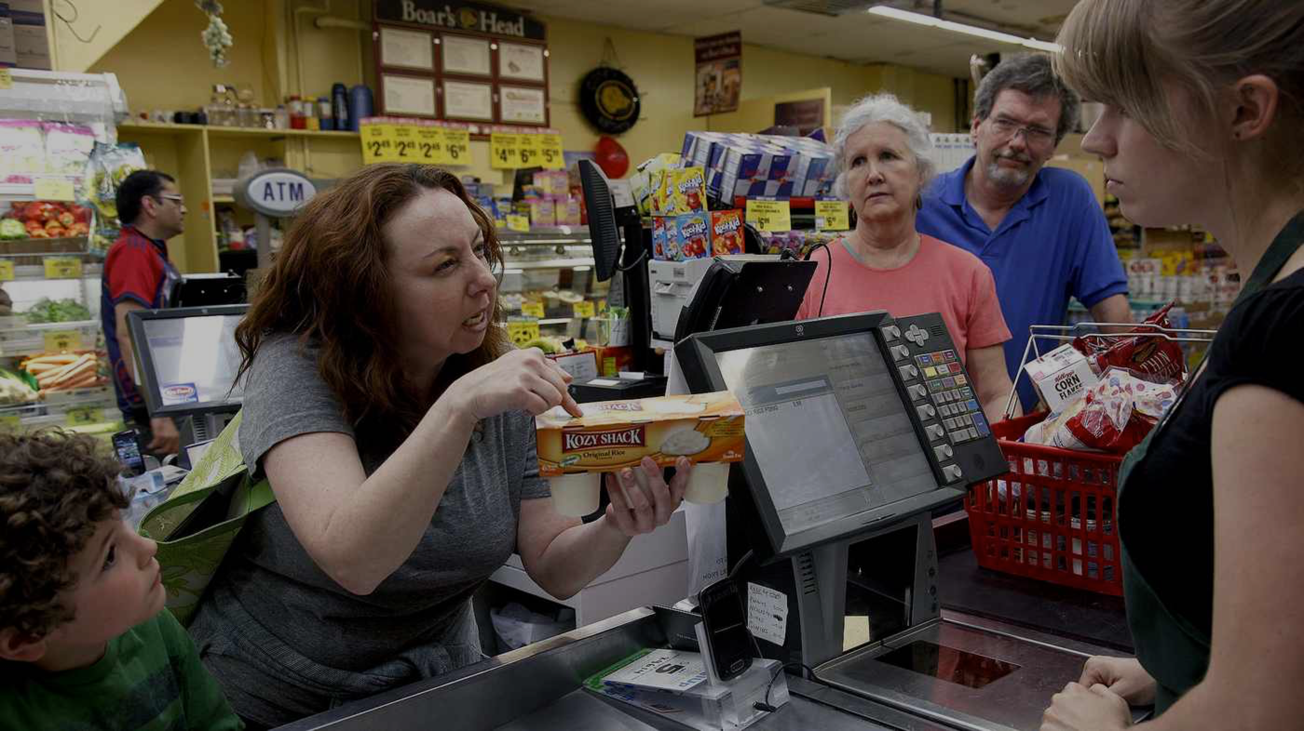

Introduction
Emotions influence
every aspect of our lives
And how we connect with each other
What we purchase
How we learn
Notes:
Facial expression plays a significant role in identifying the emotions and cognitive state of a person.
Ekman et al. described six fundamental facial expressions which are happiness, surprise, anger, sadness, fear, and disgust. These expressions are similar in all the people irrespective of gender, age, and culture.
Emotions influence very aspect of our lives. We express emotions in one or the other way in our day to day life.

Slide 4
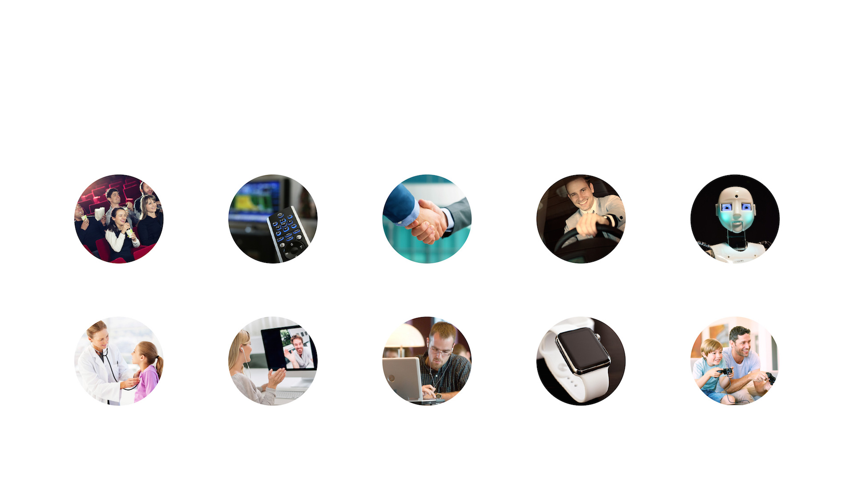
Applications of Emotion AI cut across every aspect of our daily lives .. Ultimately Emotion AI will become ubiquitous
Introduction
Media and
entertainment
Advertising
Human resources
Automotive
Robotics
Healthcare and
quantified self
Video communication
Online education
Devices
Gaming
Notes:
Automatic classification of content preference: Emotion recognition helps in determining if people liked certain advertisements or TV shows or Movies.
Social robots: Helps to build the emotional loop between users and robots. It helps the robot to identify whether the user is experiencing positive or negative feeling and take certain action based on it.
Healthcare: Used to monitor patients in the assisted living scenario and inform the medical staff during emergencies.
Educational scenarios: Automated tutors, smart classrooms and e-learning have become more popular in recent years. Cognitive state helps to recognize the student’s interest level and enhance the contents based on an automatic feedback system.
Smart Phones: Emotion recognition is used for linking life patterns to changes in mood, for example, playing music based on mood.
Entertainment industries: Cognitive state recognition gives a new dimension to gaming. Games can provide tailored experience if the cognitive state of a player is known to the game.

Slide 5
Introduction
The challenges normally faced while recognizing Cognitive state based on facial features are:
Robustness of facial feature to changes in lighting
Noise
Pose and frequent head movements
Reducing the dimensionalities
Occlusion:
Minor coverings of the face such as wearing different glasses or scraps
Different makeups and the presence of beards or moustaches
Occlusion due to hand

Slide 6
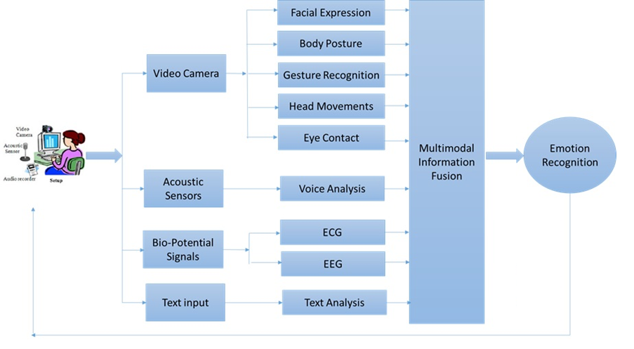
Literature Survey
Different Modalities Available for Emotion Recognition
Notes:
Further, the emotions are also recognized from one’s speech, body language, facial expressions, biosignals, breathing patterns, etc.
ECG -Electrocardiography
EEG -Electroencephalogram

Slide 7
Problem Statement
The goal of this project is to predict emotional state from the videos of a person’s face,
Our evaluation metric will be the accuracy for each emotion state, supplemented by a confusion matrix that highlights which emotions are better recognized than others.
In short,
Input: short video/live stream
Output : Emotion state recognized

Slide 8
Objectives
Objectives:
The main objectives of this project include the following:
To build a robust framework for automatic recognition of basic emotion states such as happy, surprise, sad, fear, neutral, anger, and disgust in live video.
To test and validate the emotion recognition system.

Slide 9
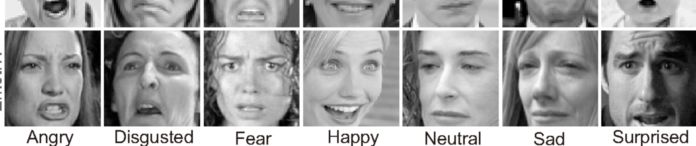
Dataset
FER 2013
Fig: Databases analyzed in projects
Dataset Specifications:
Image Details: 48x48 pixel grayscale images of faces.
Dataset Composition:
Emotion Categories: Seven categories based on facial expressions.
0:'angry', 1:'disgust', 2:'fear', 3:'happy', 4:'neutral', 5:'sad', 6:'surprise‘ 6: Neutral
Training Set: 28,709.
Validation Set: 7,178.

Slide 10
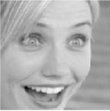
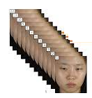
Proposed Approach
Input Image
Preprocessing
ViTTransformers
Fully connected layer
Emotion Recognition Model
Model Training
Happy
Sad
Neutral
Live Video
Video Frame
RGB to Grayscale
Haar cascade
Emotion Recognition Model
Anger
Fear
Surprise
Model Testing
Disgust

Slide 11
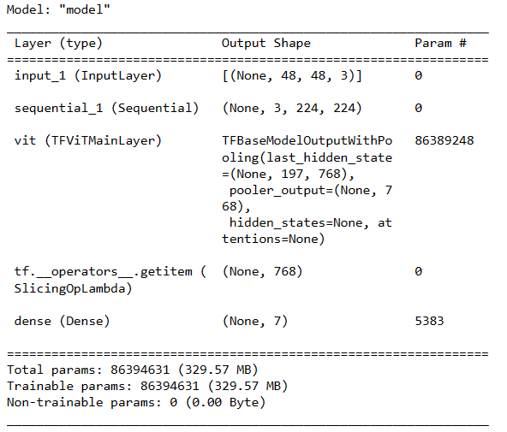
Network Architecture

Slide 12
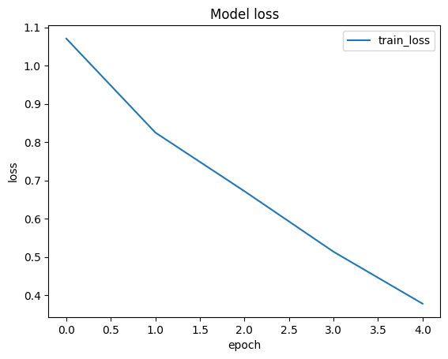
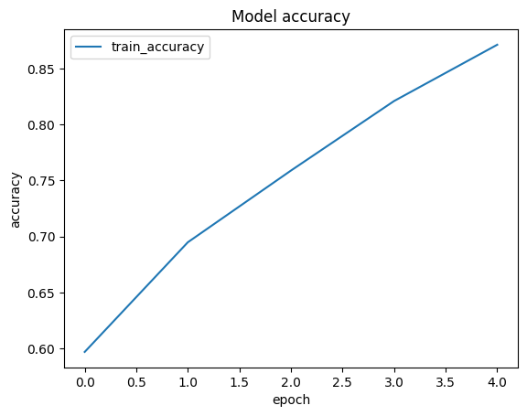
Model Loss and Model Accuracy
1150s 1s/step - loss: 1.0708 - accuracy: 0.5969 Epoch 1/5 898/898
1109s 1s/step - loss: 0.8252 - accuracy: 0.6948 Epoch 2/5 898/898
1109s 1s/step - loss: 0.6720 - accuracy: 0.7589 Epoch 3/5 898/898
1109s 1s/step - loss: 0.5138 - accuracy: 0.8210 Epoch 4/5 898/898
1109s 1s/step - loss: 0.3780 - accuracy: 0.8712 Epoch 5/5 898/898

Slide 13
Code walkthrough & Demo
Code walkthrough & Demo

Slide 14
Conclusions & Future work
Conclusion:
Successful implementation of emotion detection in live stream video using the FER 2013 dataset.
Demonstrated the potential of VisionTranformers in recognizing complex human emotions through facial expressions.
Achieved an accuracy of 95% on Human Emotions Dataset(HES) and 87.12% on FER2013
Future Work:
Explore real-time applications in diverse environments to enhance robustness against varying light and backgrounds.
Integrate multimodal emotion recognition by combining facial expressions, voice tone, and body language using Crowd-sourced Emotional Mutimodal Actors Dataset (Crema-D)
Continual learning integration to adapt to new emotions and improve accuracy over time.
Explore Swim Transformers for better accuracy

Slide 15
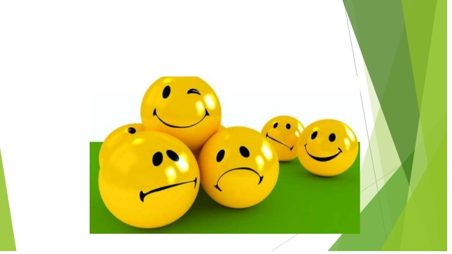
Thank You

Slide 16
References
https://www.kaggle.com/datasets/msambare/fer2013
https://www.kaggle.com/datasets/shawon10/ckplus
https://github.com/theAIGuysCode/colab-webcam
https://github.com/val-iisc/BPFC
https://github.com/mo666666/When-Adversarial-Training-Meets-Vision-Transformers
https://github.com/vtddggg/Robust-Vision-Transformer

Slide 17
Tasks Breakup
Tasks | Roles
Market Research | Vivek R
Dataset Analysis, collection & cleanup | Pooja
Model Design | Praveen
Implementation | Praveen, Vivek, Pooja
Training Model & Optimization | Praveen, Vivek, Pooja
Testing | Praveen, Vivek, Pooja
Report Writing | Praveen, Vivek, Pooja

